Slide 1
ECE 3300L
Lab 5:Multi digit up/down counter
Instructor: Dr. Mohamed El-Hadedy
Sami Elias, Joseph Popoviciu

Slide 2
Objective
Create a multi digit up/down counter. It should function similarly to the single digit up/down counter, but will have more digits than just one.

Slide 3
Clock divider
This will also include a clock divider which will slow down or speed up the counter. When none of it is enabled, the counter will be counting at max speed which we will not be able to see. The more we switch on from the clock divider, the slower the counter will be.

Slide 4
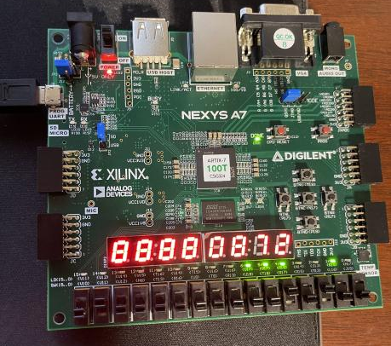
Counting
This image shows the counter going up to
three digits.

Slide 5
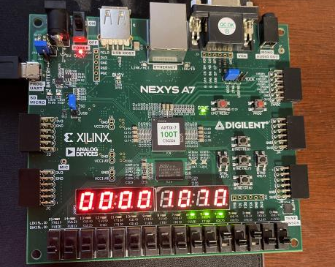
Counting cont.
This image shows the counter going up to
four digits

